Slide 1
Online Role-based training resources: Microsoft Learn https://docs.microsoft.com/en-us/learn/

Slide 2
Module 11: Manage Files and Datasets in Power BI

Slide 3
Learning Objectives
You will learn the following concepts:
Parameters
Datasets
Notes:
By the end of this module, you’ll be able to:
Manage datasets and parameters
Build dynamic reports with parameters
Dataset scheduled refresh options
Troubleshooting gateway service connectivity

Slide 4
Lesson 1: Parameters

Slide 5
Introduction to Datasets and Parameters
Datasets are published to workspaces.
Sharing datasets are a productivity boost for report authors.
The management of datasets involves the implementation of parameters within those datasets.
Notes:
When your datasets are published to your organization's workspace in Power BI Service, everyone who needs access to those datasets can find them in a central location, and this provides opportunities for collaboration between teams.
Since preparing and cleaning data can be so time consuming, sharing datasets can be a huge productivity boost for report authors.
This sharing of datasets needs to be actively managed for optimal organizational performance.
The management of datasets also involves the implementation of clever parameters within those datasets, to aid decision making and solve business problems.
By the end of this module you'll be able to:
Create dynamic reports with parameters
Use a Power BI gateway to connect to on-premise data sources
Configure a dataset scheduled refresh
Configure incremental refresh settings
Manage and promote datasets
Troubleshoot service connectivity
Boost performance with query caching (Premium)

Slide 6
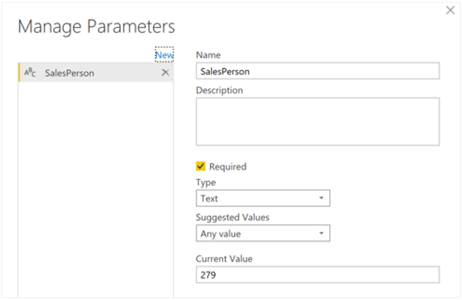
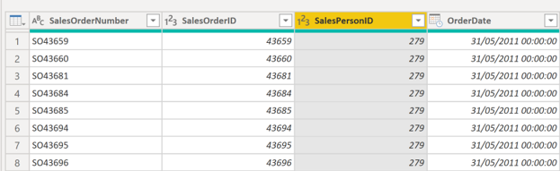
Dynamic Reports with parameters
Give end-users more power over the data that is displayed on the report.
Notes:
Dynamic reports are reports in which the data can be changed by a developer, according to user specifications. Dynamic reports are valuable, as a single report can be used for multiple purposes. If you use dynamic reports, you'll have fewer individual reports to create, which will save organizational time and resources.
You can use parameters by determining the values that you want to see data for in the report, and the report updates accordingly by filtering the data for you.
Creating dynamic reports allows you to give end-users more power over the data that is displayed in your reports; they can change the data source and filtering the data by themselves.
To cater for multiple values at a time, you first need to create an Excel worksheet that has a table consisting of one column, which contains the list of values.
Create dynamic reports for individual values
To create a dynamic report, you first need to write your SQL query and then you need to use the Get data feature in Power BI Desktop to connect to the database.
The next step is to create the parameter.
Now you need to adjust the code in SQL query, to take account of your new parameter.
Create dynamic reports for multiple values
To cater for multiple values at a time, you first need to create an Excel worksheet that has a table consisting of one column, which contains the list of values.

Slide 7
Review Questions
1
Q – What benefit does dynamic reports provide to end users?
A – It gives the more control over the data that is displayed.

Slide 8
Lesson 2: Datasets

Slide 9
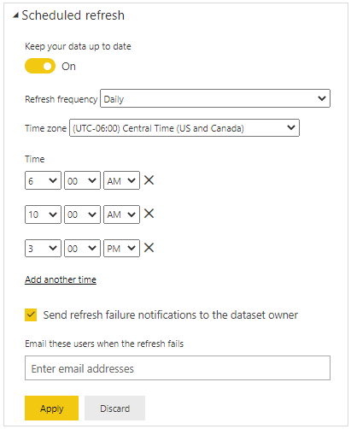
Dataset Scheduled Refresh
Re-importing data from the original data source to ensure end users have the most up-to-date data.
Notes:
The Scheduled refresh feature in Power BI Service allows you to define the frequency and time slots to refresh a particular dataset. Scheduling the refresh of your data will save you time, as you don't have to manually refresh the data. It also ensures that the end users can access the most up-to-date data.
Considering how important it is to have accurate sales data, you need to find a solution. The data usually gets updated every week but you don't want to have to come back to the report every week to manually refresh the dataset, and sometimes you forget to do it. You decide to use Power BI's scheduled refresh functionality to solve this problem.
Set up a refresh schedule
To set up a refresh schedule for your dataset, go to the Datasets + dataflows page.
NOTE: Before you can set up a refresh schedule, you must have created a gateway connection.
NOTE: Whilst you can set a time for the refresh, be aware that the refresh might not take place at that exact time. Power BI starts scheduled refreshes on a best effort basis. The target is to initiate the refresh within 15 minutes of the scheduled time slot, but a delay of up to one hour can occur if the service can't allocate the required resources sooner.
Perform an on-demand refresh
In addition to the scheduled refreshes, you can refresh a dataset at any time by performing an on-demand refresh. This type of refresh doesn't affect the next scheduled refresh time.
Check the refresh status and history
You can check the refresh status and history at any time. This is useful if you want to find out when the last refresh occurred and when the next one is scheduled. It is also good practice to check the status of your datasets from time to time, to see if there have been any refresh errors.

Slide 10
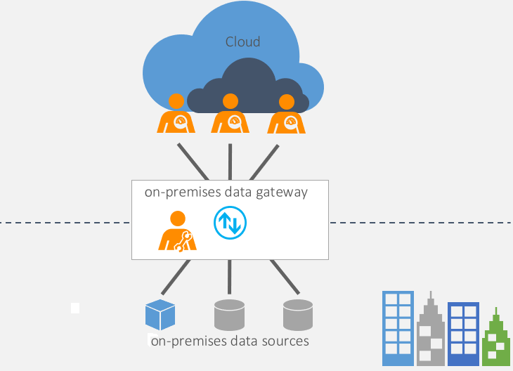
Troubleshooting Service Connectivity
Two types of on-premises Gateways:
Organization mode.
Personal mode.
Both modes require the installation of the data gateway on-premises.
Notes:
Gateway software acts like a bridge - it allows organizations to retain databases and other data sources on their on-premises networks, and access that on-premises data in cloud services, such as Power BI and Azure Analysis Services.
A gateway facilitates quick and secure behind-the-scenes communication flowing from a user in the cloud to your on-premises data source, and then back again to the cloud.
There are two types of on-premises gateway:
Organization mode - Allows multiple users to connect to multiple on-premises data sources and is suitable for complex scenarios.
Personal mode - Allows one user to connect to data sources. This type of gateway can be used only with Power BI and it can't be shared with other users, so it is suitable in situations where you're the only one in your organization who creates reports. You install the gateway on your local computer, which needs to stay online in order for the gateway to work.
Use on-premises gateway
Before you can connect to your on-premises data source, you need to install the on-premises data gateway, then configure it to suit your organizational needs. This task is usually done by an admin in your organization.
Troubleshoot on-premises data gateway
Troubleshooting a gateway is an ever-changing topic. Please reference the following documents for the latest troubleshooting guidance:
Learn how to run a network port test
Learn how to provide proxy information for your gateway.
Find the current data center in your region.
Cloud services like SharePoint Online do not require any gateway, as the data is already in the cloud. You only need to provide your authorization credentials to setup a data source connection.

Slide 11
Review Questions
1
Q – Where are the dataset-scheduled refreshes configured?
A – Power BI Service

Slide 12
Module Overview
We covered the following concepts:
Parameters
Datasets
Notes:
In this module we discussed:
How to manage datasets and parameters
How to build dynamic reports with parameters
Dataset scheduled refresh options
How to troubleshoot gateway service connectivity

Slide 13

References
PL-300 Manage datasets in Power BI
https://docs.microsoft.com/en-us/learn/modules/manage-datasets-power-bi/
Notes:
It is good practice to tie back your ILT deliveries to role-based learning materials on Microsoft Learn. What is listed here should supplement your delivery and the role-based training your course is affiliated with. It is important to give the learners continued education opportunities for growth.
Steps:
Insert the page title here along with the url to other Microsoft resources
It is only necessary to duplicate this slide if there are more than 6 references that need to be shared with the students.

Slide 14
Closing slide

